Slide 1

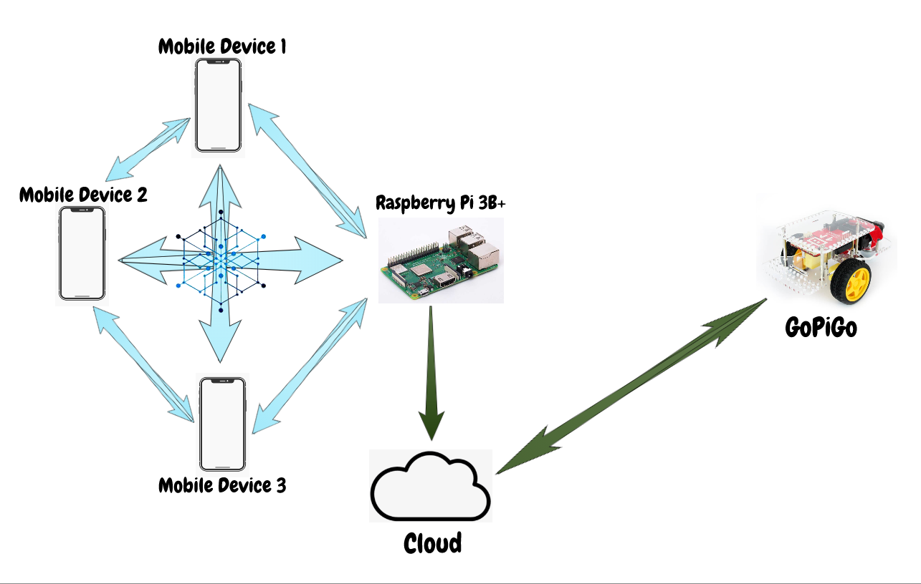
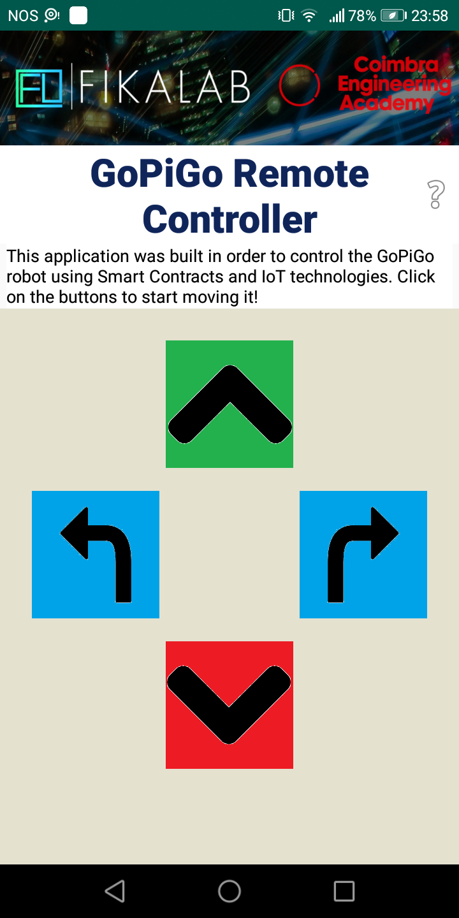
ISEC 2019
So you want to enjoy Blockchain’s advantages, but you require an IoT? We have the perfect architecture for you!
Blockchain Benefits
Security
Immutability
Auditability
Cloud Benefits
“Infinite” storage
“Infinite” processing power
Scalability
+
Members
Tiago Ferreira – Project Manager
Luís Silvestre – Blockchain Developer
Rodrigo Rafael – Software Developer
Blockchain for IoT: a Smart Contracts Approach

Slide 2
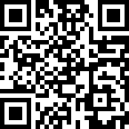
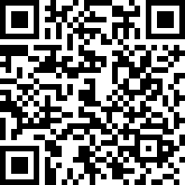
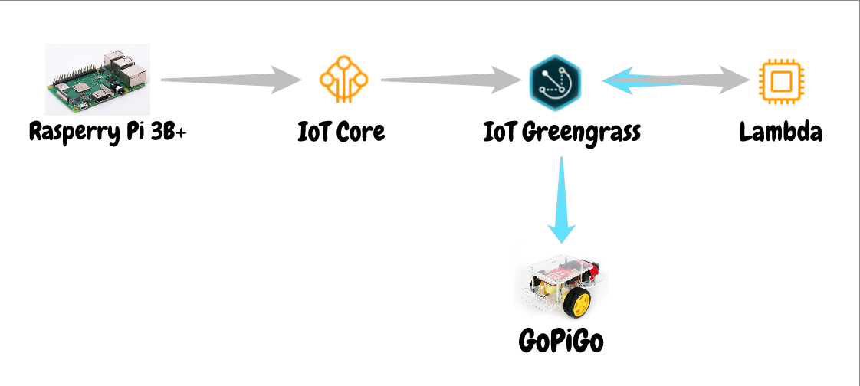
Ok, so what is this?
This is a proof of concept for a management system that requires the manipulation of various devices or objects from different entities, using blockchain and Internet of Things.
Things used in this project:
Devices
Android devices
Rapberry Pi 3B+, a credit card sized single board computer with Wi-Fi
GoPiGo, a robot car that works with the help of a Raspberry Pi
Blockchain Technologies
Ethereum, a blockchain platform that allows for the development and execution of Smart Contracts
Infura, a service that provides online nodes on the Ethereum networks, allowing connected devices to interact with the blockchain without the need of having a full copy of the network
Smart Contracts are programmable contracts that run on the Blockchain. They run on the Ethereum Virtual Machine and allow the creation of Decentralized Applications on Blockchain network, also known as DApps
Cloud Technologies
Amazon Web Services Cloud
AWS IoT Core, a service that allows devices to easily connect to the Cloud or to other devices
AWS IoT Greengrass, a service that seamlessly extends other services to edge devices so they can act locally on the data they generate , while still using the cloud for management, analytics, and durable storage
AWS Lambda, a service that lets run code in Cloud or in other devices when working with AWS IoT Greengrass
Blockchain Pathway
Mobile devices and Raspberry connect to online Ethereum node through Infura
Smart Contract is loaded in the network
Devices Interact with the Blockchain through the Smart Contract
Raspberry Pi detects new actions through events sent by the Smart Contract
Cloud Pathway
Raspberry Pi sends a message to AWS Cloud IoT Core
IoT Greengrass reads the message from IoT Core
IoT Greengrass triggers Lambda function
Lambda function runs on every device connected to the Cloud through IoT Greengrass
So where can I use this architecture?
On any system that needs to have a secure part and an IoT part. An objective example of this would be an agribusiness management service, where multiple managers around the world, through one application, could manage various tractors, represented in this project as the GoPiGo. Thus, if there was mismanagement by any member, this would be noted "forever" on the blockchain, and the other managers could act accordingly.

